Slide 1






Advance Libraries
NAME : POSHIYA KEVAL BHARATBHAI
ROLL NO. : 14
ENROLLMENT NO : 2302030400077
CLASS : 4_CE_B
PYTHON ASSIGNMENT 3

Slide 2


Advance Libraries
Exploring the essential libraries in Python for various applications.

Slide 3


Introduction
This presentation covers the various types of libraries in Python, focusing on popular libraries, their installation, and use cases.

Slide 4
Standard Libraries
Standard libraries include modules that come bundled with Python and provide core functionalities like file I/O, system commands, math operations, and more. Examples include os, sys, and math.

Slide 5



Third-Party Libraries
These libraries are created by the community and can be installed via package managers like pip. They extend Python's functionality and cater to various domains like web development, data analysis, and more. Examples include requests, Flask, and Django.

Slide 6

Built-in Libraries
Built-in libraries are part of the Python language itself and are always available to use. They include modules such as itertools for creating iterators and functools for higher-order functions, enhancing code efficiency.

Slide 7
NumPy
NumPy is the fundamental package for numerical computing in Python. It provides support for arrays, matrices, and a collection of mathematical functions to operate on these data structures, making it a cornerstone for scientific computing.

Slide 8

Pandas
Pandas is an essential library for data manipulation and analysis. It provides data structures like Series and DataFrame that allow for easy data manipulation, including filtering, grouping, and joining datasets efficiently.

Slide 9
Matplotlib
Matplotlib is a plotting library that enables the creation of static, animated, and interactive visualizations in Python. It is highly customizable and is often used for creating graphs and charts from data.

Slide 10
Data Analysis
Data analysis involves using libraries like Pandas and NumPy to manipulate and analyze datasets, enabling insights to be drawn from large data sources. This can include tasks like cleaning data, performing statistical analyses, and visualizing results with Matplotlib.

Slide 11

Web Development
Python libraries such as Flask and Django enable rapid web application development. They provide tools for routing, database interaction, template rendering, and more, streamlining the process of building and maintaining web applications.

Slide 12
Machine Learning
Libraries like Scikit-learn and TensorFlow offer powerful tools for implementing machine learning algorithms. These libraries facilitate data preprocessing, model training, and evaluation, allowing developers to build and deploy machine learning models effectively.

Slide 13
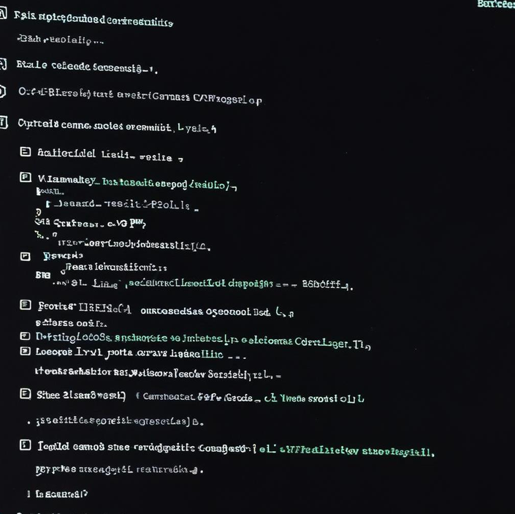
Using pip
Pip is the standard package manager for Python that allows users to install and manage additional libraries and dependencies not included in the standard library. With commands like 'pip install library_name', installing packages is straightforward and efficient.

Slide 14
Virtual Environments
Virtual environments allow developers to create isolated spaces for projects, ensuring that dependencies do not conflict with other projects. Tools like venv or virtualenv can be used to create and manage these environments easily.

Slide 15
Configuration Management
Managing configurations effectively is critical for ensuring that Python applications run smoothly. Tools like pipenv and poetry help manage dependencies and environment settings, improving project standardization and deployment processes.

Slide 16
Code Organization
Organizing code effectively enhances readability and maintainability. Best practices include following the PEP 8 style guide, structuring code into modules and packages, and consistently applying conventions throughout the codebase, resulting in cleaner, more manageable projects.

Slide 17
Library Documentation
Maintaining thorough documentation for libraries is essential for usability. Well-documented codes, including clear function definitions, usage examples, and explanations of parameters, allow users to understand and efficiently utilize libraries without confusion.

Slide 18
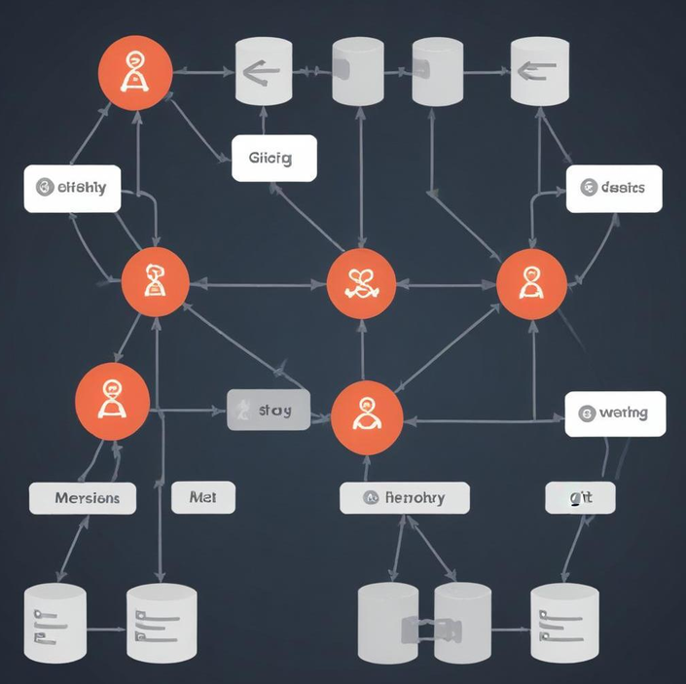
Version Control
Implementing version control with tools like Git enables better collaboration and keeps track of code changes over time. This practice allows for easy rollback to previous versions and management of features through branches, making teamwork seamless and organized.

Slide 19
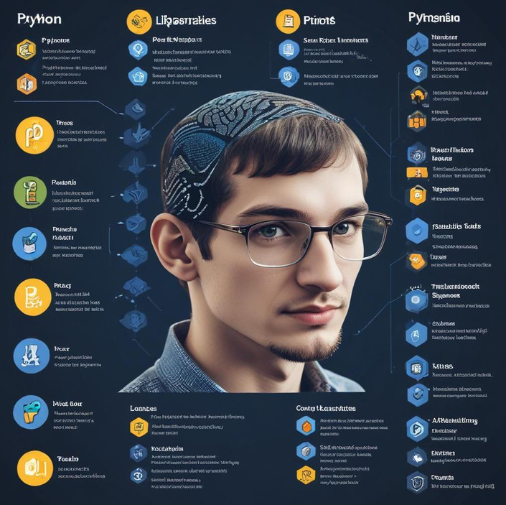
Conclusions
The exploration of Python libraries reveals their significant impact on various fields like data analysis, web development, and machine learning. Proper installation and adherence to best practices are instrumental for maximized efficiency and effectiveness in Python programming.

Slide 20





Thank you!
Do you have any questions?

